Slide 1
QuickTest Professional 10.0 Fundamental
SHREK Team – Change Lu

Slide 2
Agenda
Automation Testing
QTP Introduction
Understanding the Test Object Model
VBScript Introduction
Working With QTP
QTP Test Development Process
Debugging
Test Settings
QTP Options
Useful Methods/Codes/Tools
QTP Learning Guide
Practice

Slide 3
Automation Testing
What is Automation Testing
Two general approaches of Automation Testing
Automation Regression Testing vs. Manual Regression Testing
Advantage and Disadvantage of Automation Testing
Good and Poor Candidate for Automation Testing
Common problems of Automation Testing
Before getting started Automation Testing
Automation Testing Lifecycle Methodology
Automation Script Development Process
Automation Testing Tools

Slide 4
What is Automation Testing
Manual Testing
Automation Testing
Design
Design
Data Input
Operation
Excepted results
Implementation
Execution
Execution
4

Slide 5
What is Automation Testing
Automation Testing is the use of software to control the execution of tests, the comparison of actual results to expected results, the setting up of test preconditions, and other test control and test reporting functions.

Slide 6
Two general approaches of Automation Testing
Code-driven testing
The public (usually) interfaces to classes, modules, or libraries are tested with a variety of input arguments to validate that the results that are returned are correct.
Graphical user interface (GUI) testing
A testing framework generates user interface events such as keystrokes and mouse clicks, and observes the changes that result in the user interface, to validate that the observable behavior of the program is correct.

Slide 7
Automation Testing is good at
Repeatable Operations
Huge Volume Data Input/output
Data Compare
Data Calculation
Mass Concurrent Users Operation
…

Slide 8
Automation Testing is good at
Common methods of regression testing include re-running previously run tests
Checking whether previously-fixed faults have reemerged.
Regression Testing

Slide 9
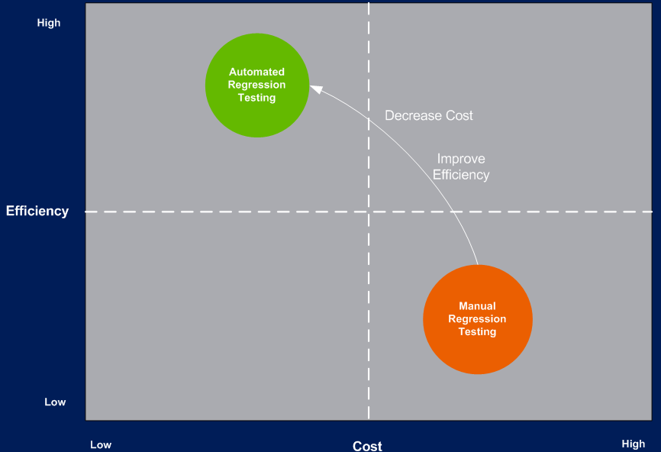
Automation Regression Testing vs. Manual Regression Testing
`
Automation
Regression
Testing
Manual
Regression
Testing

Slide 10
Advantage of Automation Testing
Fast
Tools run tests significantly faster than human users, especial in Regression Test.
Reliable
Tests perform precisely the same operations each time they are run, thereby eliminating human error.
Repeatable
You can test how the Web site or application reacts after repeated execution of the same operations.
Programmable
You can program sophisticated tests that bring out hidden information.
Comprehensive
You can build a suite of tests that covers every feature in your Web site or application.
Reusable
You can reuse tests on different versions of a Web site or application, even if the user interface changes.

Slide 11
Disadvantage of Automation Testing
No human insight
Need implementation effort
Need maintenance effort for data/application change

Slide 12
Good Candidate for Automation Testing
Regression testing times > 4
Performance Testing, Load Testing, Press Testing
Time-consuming data validation/calculation
Repeatable operation
Release frequently
…

Slide 13
Poor Candidate for Automation Testing
Cross-application test cases with uncertain interrupted time (ex. Time of data flow)
Test cases that need frequent human intervention (e.g. Data change)
Checkpoints require subjective judgment or cannot be validated by automation tool (ex. To verify page / file format)
…

Slide 14
Common problems of Automation Testing
Unrealistic expectations
Poor testing practice
Expectation that automated tests will find a lot of new defects
False sense of security
Maintenance of automation test cases

Slide 15
Before getting started Automation Testing
A significant investment
Automation Testing Resources
Need Organization support
A software development process
Capability Maturity for Software Project
Automation Testing is a long term process

Slide 16
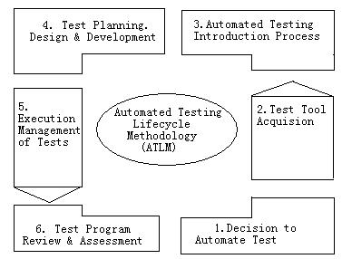
Automation Testing Lifecycle Methodology (ATLM)

Slide 17
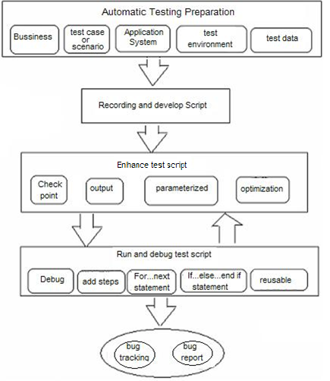
Automation Script Development Process

Slide 18
Automation Testing Tools Recognition/Control Principle
Code-driven testing tools
Function(object) Call
Web-Browser based testing tools
HTML DOM
GUI based automation testing tools
Windows API
other technologies, e.g. Dot Net Reflection

Slide 19
Automation Testing Tools Type
Commercial testing tools
Open Source testing tools
Self-Development testing tools
Mature
Low cost
Low cost
Service Support
Good extension
Developer Community Support
Practical
Time Cost
Expensive
Technical Issue
Technical Issue

Slide 20
Main Automation Testing Tools
Tool name | Manufacture | Latest version
HP QuickTest Professional | HP | 11.5
IBM Rational Functional Tester | IBM Rational | 8.1.0.3
Parasoft SOAtest | Parasoft | 9.0
Ranorex | Ranorex GmbH | 3.0
Rational robot | IBM Rational | 2003
Selenium | Open source | 1.0.6
SilkTest | Micro Focus | 2010
TestComplete | SmartBear Softwar | 8.2
TestPartner | Micro Focus | 6.3
Visual Studio Test Professional | Microsoft | 2010
WATIN | Open source | 2.0
WATIR | Open source | 1.6.5

Slide 21

QTP Introduction
What is QTP
Business Process Testing
Keyword-driven Testing
VBScript-based Expert View
Keyword View
Documentation in Keyword View
QTP IDE

Slide 22
What is QTP
HP QuickTest Professional, the advanced solution for functional test and regression test automation.
QuickTest Professional provides add-ins that enable you to test objects (controls) created in commonly used development environments.
This next-generation automated testing solution deploys the concept of keyword-driven testing to enhance test creation and maintenance.

Slide 23
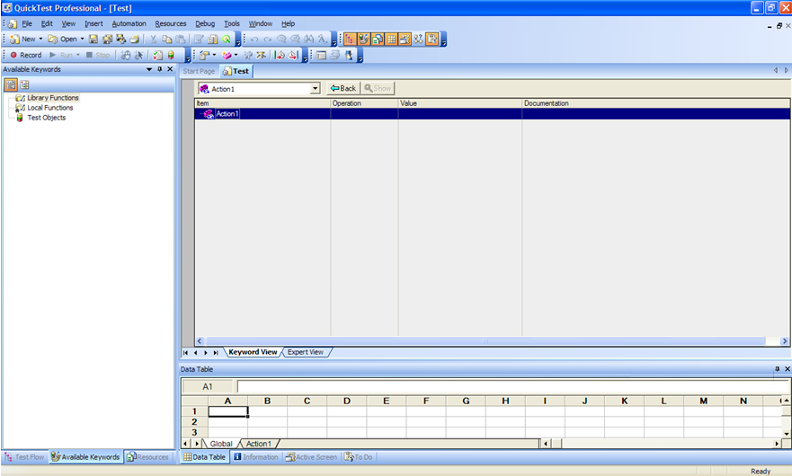
What is QTP

Slide 24
Keyword-driven Testing
Keyword-driven testing is a technique that separates much of the programming work from the actual test steps so that the test steps can be developed earlier and can often be maintained with only minor updates, even when there are significant changes in your application or your testing needs.

Slide 25
Business Process Testing
Business Process Testing is a role-based testing model.
Integration between QuickTest and QualityCenter enables the Automation Engineer to effectively maintain the resources and settings, while enabling Subject Matter Experts to implement business process tests.
Subject Matter Experts
who understand the various parts of the application being tested
create business process tests in QualityCenter.
Automation Engineers
who are experts in QuickTest and automated testing
With QuickTest, AE define all of the resources and settings required to create business process tests.

Slide 26
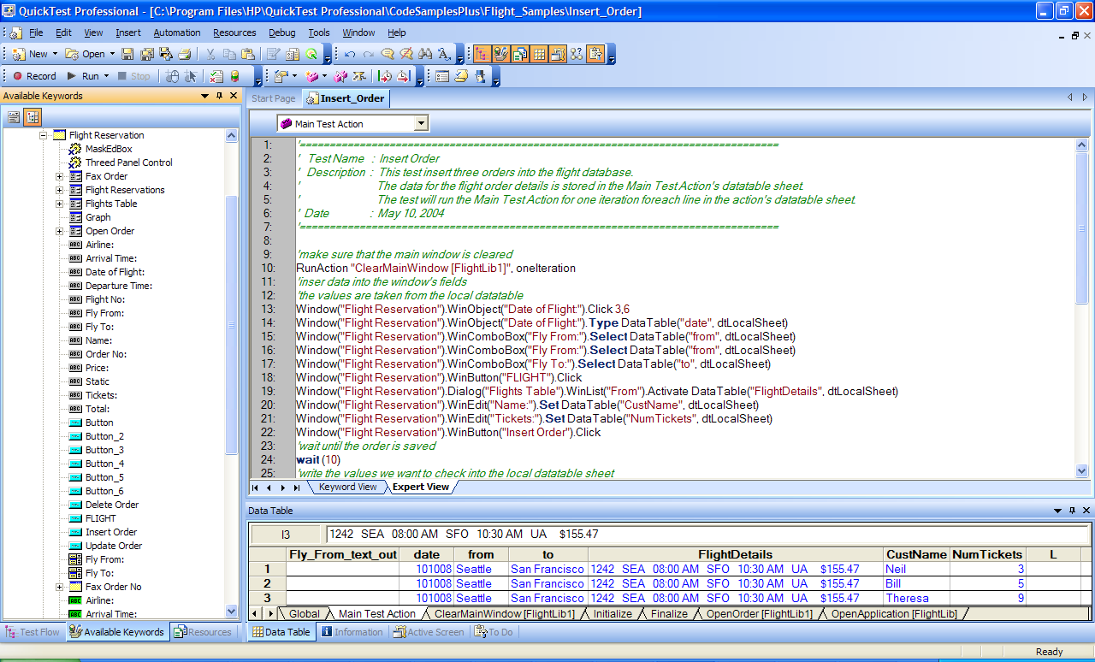
VBScript-based Expert View

Slide 27
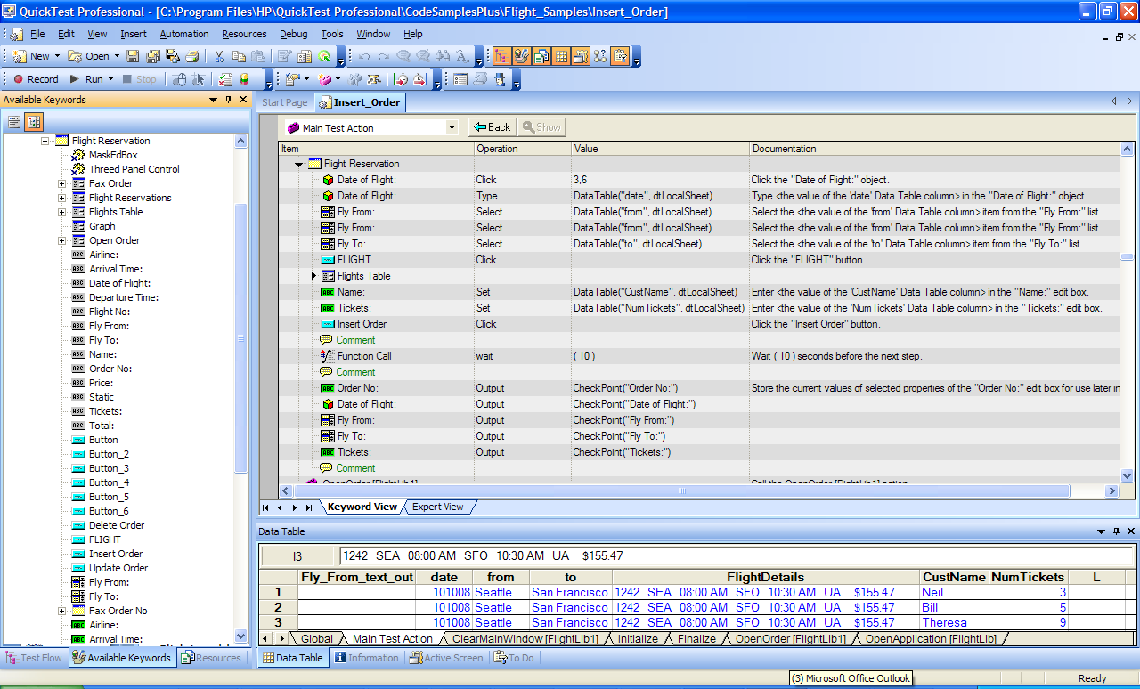
Keyword View

Slide 28
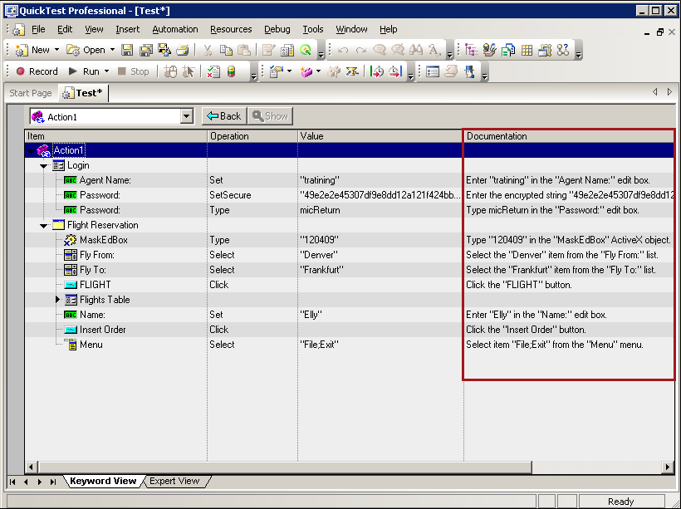
Documentation in Keyword View

Slide 29
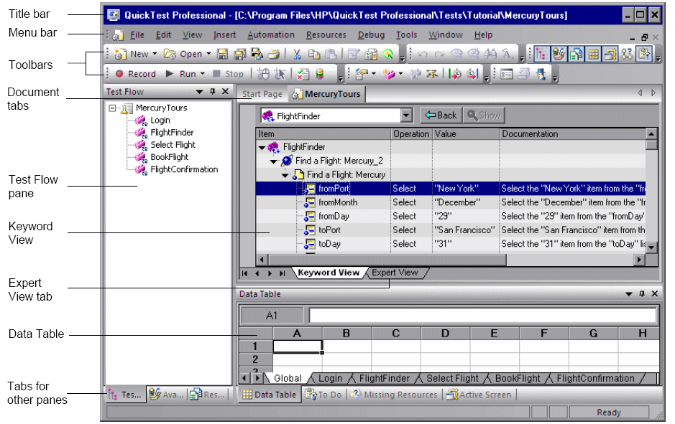
QTP IDE

Slide 30
Demo – QTP Introduction
Launch QTP
Expert View
Keyword View
Documentation in Keyword View
QTP IDE

Slide 31
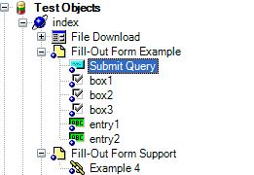
Understanding the Test Object Model
Understanding How QTP Learns Objects
Understanding Test Object Descriptions
Understanding How QTP Identifies Objects During the Run Session

Slide 32
Understanding How QuickTest Learns Objects
First, it "looks" at the object being learned and stores it as a test object, determining in which test object class it fits.
Then, QuickTest "considers" identification properties for the test object. For each test object class, QuickTest has a list of mandatory properties that it always learns;
If it is not, QuickTest adds assistive properties, one by one, to the description, until it has compiled a unique description;
If those available are not sufficient to create a unique description, QuickTest adds a special ordinal properties.

Slide 33
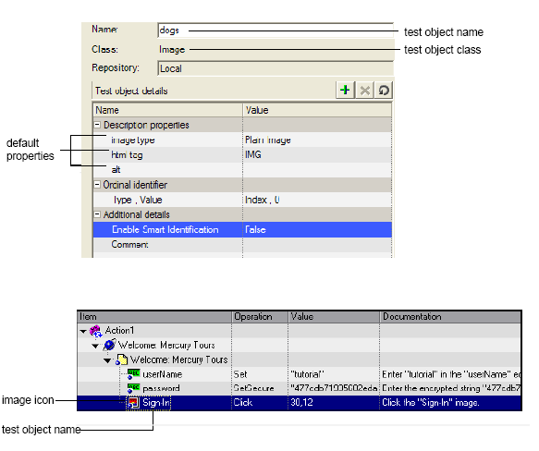
Understanding Test Object Descriptions

Slide 34
Understanding How QuickTest Identifies Objects During the Run Session
During a run session, QuickTest searches for a run-time object that exactly matches the description of the test object it learned previously. It expects to find a perfect match for both the mandatory and any assistive(ordinal) properties it used to create a unique description while learning the object.
Even when the learned description is no longer accurate, with its Smart Identification mechanism to identify an object.

Slide 35
VBScript Introduction
Dim Top, Bottom, Left, Right
B = 200
Dim A(10)
Const MyString = "This is my string.“
Const MyAge = 49

Slide 36
VBScript Introduction
Sub ConvertTemp()
temp = InputBox("Please enter the temperature in degrees F.", 1)
MsgBox "The temperature is " & Celsius(temp) & " degrees C."
End Sub
Function Celsius(fDegrees)
Celsius = (fDegrees - 32) * 5 / 9
End Function
ConvertTemp
Call Celsius(70)

Slide 37
VBScript Introduction
If...Then...Else statement
If condition Then
[statements]
[ElseIf condition-n Then
[elseifstatements]]
[Else
[elsestatements]]
End If
Case Else
Select Case testexpression
[Case expressionlist-n
[statements-n]] . . .
[Case Else expressionlist-n
[elsestatements-n]]
End Select

Slide 38
VBScript Introduction
For...Next statement
For counter = start To end [Step step]
[statements]
[Exit For]
[statements]
Next
For Each...Next statement
For each element in group
[statements]
[Exit For]
[statements]
Next [element ]

Slide 39
VBScript Introduction
While statement
While condition
statement
Wend
Do...Loop Statement - 2
Do
[statements]
[Exit Do]
[statements]
Loop [{While | Until} condition]
Do...Loop Statement - 1
Do [{While | Until} condition]
[statements]
[Exit Do]
[statements]
Loop

Slide 40
Working with QTP
Action
Data Table
Object Repository
Parameterized
Synchronization
Checkpoint
Output Value
Function Lib
Descriptive Programming
Recovery Scenario
Virtual Object

Slide 41
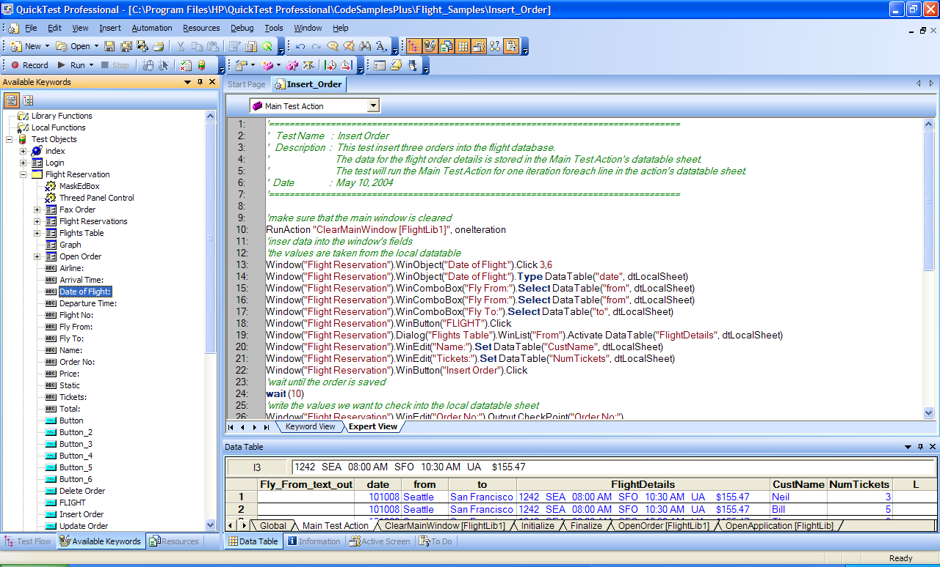
3 main parts of a QTP Script
Action
OR
Data Table

Slide 42
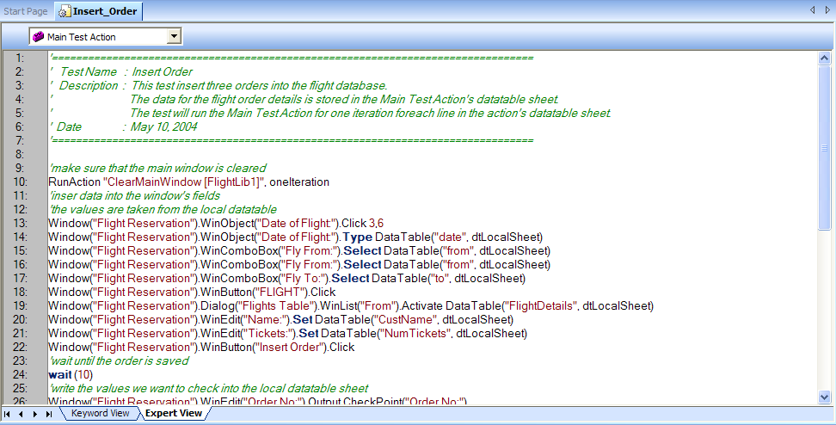
Action
Action Type
Action Parameter
Action Operation

Slide 43
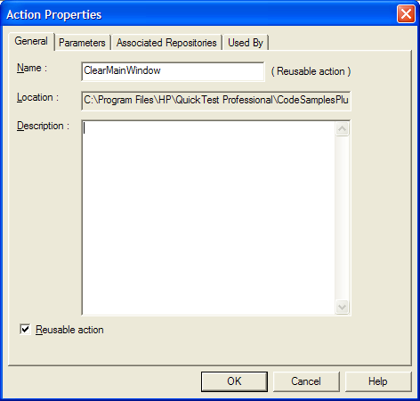
Action Type
View by Reusability
Reusable Action
Un-reusable Action
View by Location
Internal Action
External Action

Slide 44
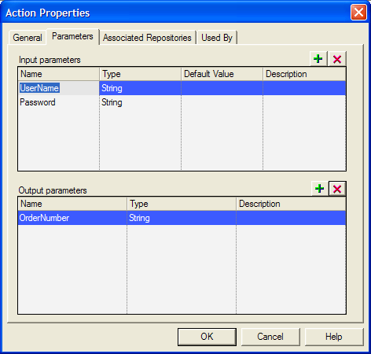
Action Parameter
Action Parameter
Test Parameters

Slide 45
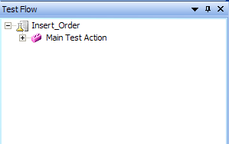
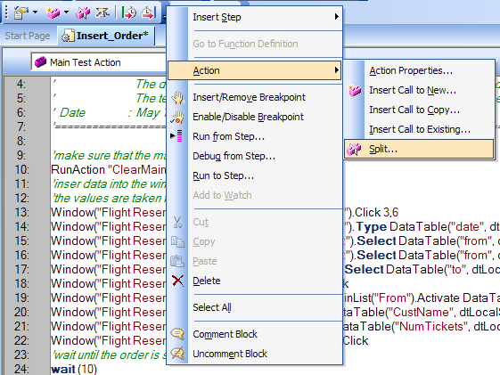
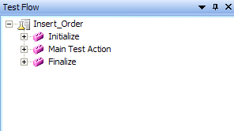
Action Operation
Split Action

Slide 46
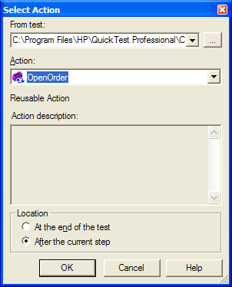
Action Operation
Call to Actions
Call to New Action
Call to Copy of Action
Call to Existing Action

Slide 47
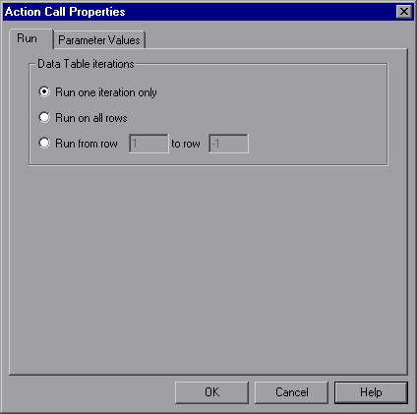
Action Operation
Action Call Properties
DataTable iterations
Parameter Values

Slide 48
Demo – Action
Action Type
Reusable Action
Un-Reusable Action
Action Parameter
Add Action/Test Parameter
Delete Action/Test Parameter
Action Operation
Split
Call
Action Call Properties Setting

Slide 49
Object Repository
Using Object Spy
Object Repository Type
Object Repository Window
Object Repository Management
Object Repository Manager Tool
Associating Object Repositories with Actions

Slide 50
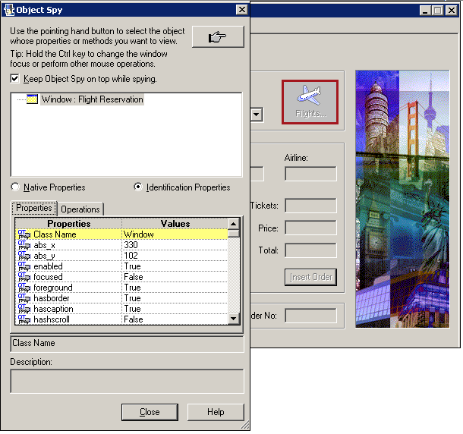
Using Object Spy

Slide 51
Object Repository Type
Local Object Repository
Objects used only for Local Action
Shared Object Repository
Objects used for associated Actions

Slide 52
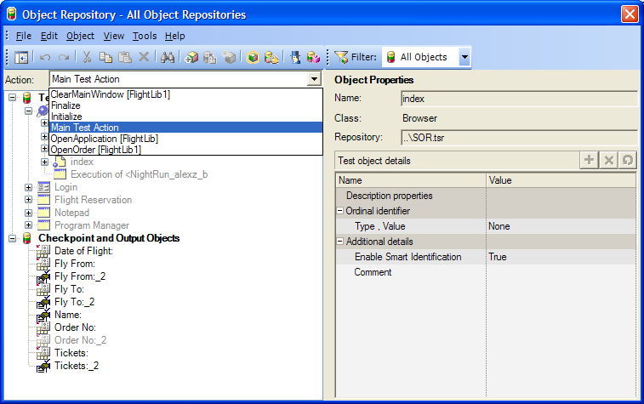
Object Repository Window

Slide 53
Object Repository Management
Add New Object
Export Local Object Repository to Shared one
Update Object

Slide 54
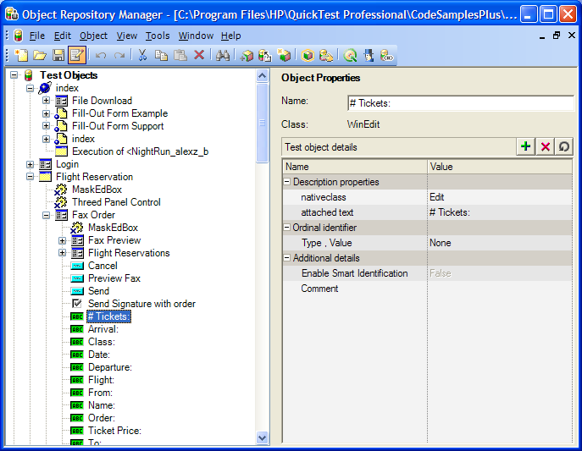
Object Repository Manager Tool

Slide 55
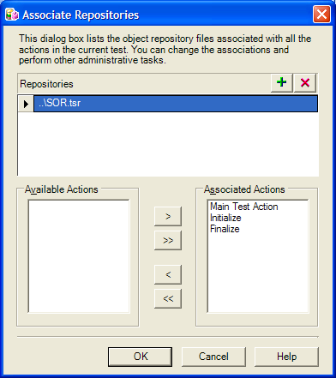
Associating Object Repositories with Actions

Slide 56
Demo - Object Repository
Using Object Spy
Object Repository Type
Object Repository Window
Object Repository Management
Object Repository Manager Tool
Add New Object
Export Local Object Repository to Shared one
Update Object
Associating Object Repositories with Actions

Slide 57
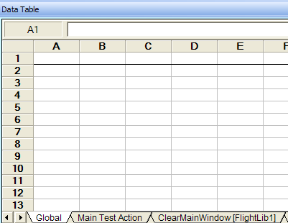
DataTable
Type
Local Sheet
Global Sheet
Property
RawValue
Value
Method
SetCurrentRow
GetCurrentRow
GetRowCount

Slide 58
DataTable Type
Local Sheet
Global Sheet

Slide 59
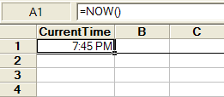
DataTable Property
RawValue
Value
DataTable. RawValue(“CurrentTime”, dtLocalSheet)
DataTable. Value(“CurrentTime”, dtLocalSheet)

Slide 60
DataTable Method
GetCurrentRow
row = DataTable.GetCurrentRow
Reporter.ReportEvent 1, "Row Number", row
GetRowCount
rowcount = DataTable.GetSheet("MySheet").GetRowCount
Reporter.ReportEvent micDone, "There are " &rowcount, "rows in the data sheet."
SetCurrentRow
DataTable.SetCurrentRow(i)

Slide 61
Demo - DataTable
Type
dtLocalSheet
dtGlobalSheet
Property
RawValue
Value
Method
SetCurrentRow
GetCurrentRow
GetRowCount

Slide 62
Parameterized
Parameter Type
DataTable Parameters
Environment Parameters
Action/Test Input/output Parameters
Random Number Parameters
Why use parameters?
Data change
Data-Driven Test
What can be parameterized?
Input data
Output data
Checkpoints
Properties of objects in OR

Slide 63
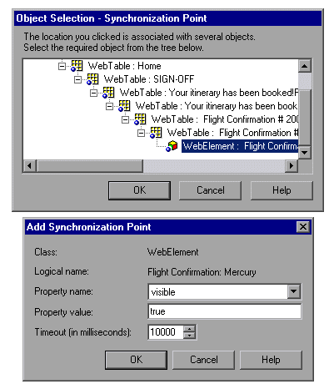
Synchronization

Slide 64
Synchronization
Object.Exist
Object.Sync
Object.WaitProperty
Wait

Slide 65
Checkpoint
Checkpoint Type
Accessibility
Bitmap
Database
Image
Page
Standard
Table
Text
Text Area
XML

Slide 66
Checkpoint
What can be set checkpoints?
Properties of objects
Text – Supported only in Web applications
Table – Web and Active X, some external add-in environments
Database
Bitmap
XML
Where can we add checkpoint steps?
Codes
Active screen
“Insert” menu

Slide 67
Checkpoint
Where the expected data comes from?
Value of object’s property
Run-Time DataTable
Environment parameter
Note:
Checkpoint statement return a logical value (true or false).
Standard checkpoint/output steps can be added after recording, while text checkpoint/output steps can only be added during recording.

Slide 68
Output Value
Output Value Type
Standard output values
Text and text area output values
Table output values
Database output values
XML output values

Slide 69
Output Value
What can be set as output?
Property of object
Text
Database
XML
Where can we add output step?
Tree
Active screen
“Insert” menu
Where the data can be put into?
Run-Time DataTable
Variable
Environment parameter

Slide 70
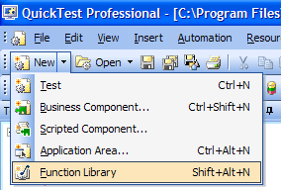
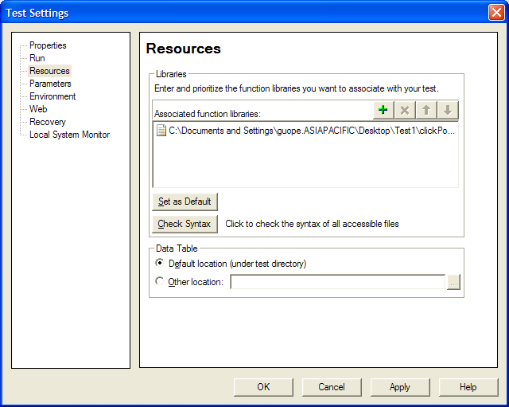
Function Lib

Slide 71
Function Lib
File > Settings > Resource
Absolute path
Relative path
In the test folder
In other folder
Tools > Options > Folders
Quality Center Path

Slide 72
Descriptive Programming
Browser("title:=Google").Page("title:=Google").WebEdit("name:=q").Set "qtp"
Browser("title:=Google").Page("title:=Google").WebButton("name:=Google Search").Click

Slide 73
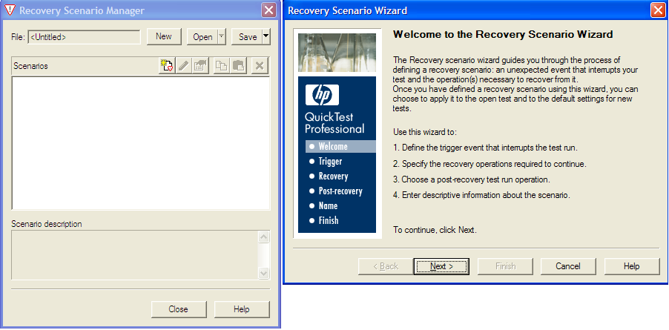
Recovery Scenario

Slide 74
Recovery Scenario
Handling unexpected events and errors
A script can have any number of recovery scenarios associated with it.
Options > Recovery Scenario Manager
Test > Setting > Recovery
Components of a recovery scenario
Trigger Event
Recovery Operation (s)
Post-Recovery Test Run Option

Slide 75
Recovery Scenario
Trigger Event
Pop-up window
Object State
Test Run Error
Application Crash
Recovery Operation (s)
Keyboard or mouse operation
Close application process
Function call
Restart Microsoft Windows

Slide 76
Recovery Scenario
Post-Recovery Test Run Option
Repeat current step and continue
Proceed to next step
Proceed to next action or component iteration
Proceed to next iteration
Restart current run
Stop the test run

Slide 77
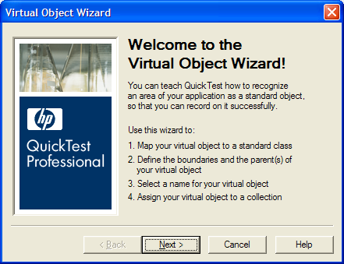
Virtual Object

Slide 78
Virtual Object
The reason of using Virtual object is that the objects behave like standard objects but are not recognized by QuickTest.
A virtual object is a defined area on the screen that you configure to behave as one of the standard Windows objects.
Save path: <QuickTest installation folder>\dat\VoTemplate
Not recommended: Virtual objects can’t change their coordinate automatically.

Slide 79
Demo - Working with QTP
Checkpoint
Output Value
Function and Function Lib
Recovery Scenario
Virtual Object

Slide 80
QTP Test Development Process
Prepare
Create
Enhance
Debug & Run
Prepare the automated test environment
Record user actions to generate a basic test
Enhance the automated test
Make test work well
Setup for test automation
Create a basic test
Enhance test
Debug and Run test
Document manual test steps
Check application environment stability
Check that data is valid
Record user actions
Confirm successful playback
Use Object Repository
Add synchronization
Insert checkpoints
Data drive the test
Debug
Run
Insert output
Add Steps
Add If Else statement
Add Loop statement

Slide 81
Training Project
Applying QTP Test Development Process
QTP Test Implementation

Slide 82
QTP Test Development Process
Prepare
Create
Enhance
Debug & Run
Prepare the automated test environment
Record user actions to generate a basic test
Enhance the automated test
Make test work well
Setup for test automation
Create a basic test
Enhance test
Debug and Run test
Document manual test steps
Check application environment stability
Check that data is valid
Record user actions
Confirm successful playback
Use Object Repository
Add synchronization
Insert checkpoints
Data drive the test
Debug
Run
Insert output
Add Steps
Add If Else statement
Add Loop statement

Slide 83
Automated a Test Case with QTP
Test Case
Navigate to Mercury Tour Websites
Login to website, check logon successfully
Click Flights link, verify that you go to Flight screen
Enter city, data info and click continue button, verify that correct flight returned

Slide 84
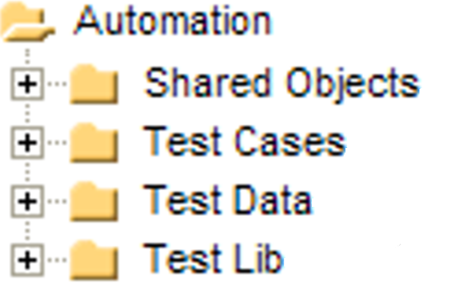
QTP Tests and Resource Repository

Slide 85
QTP Test Development Process
Prepare
Create
Enhance
Debug & Run
Prepare the automated test environment
Record user actions to generate a basic test
Enhance the automated test
Make test work well
Setup for test automation
Create a basic test
Enhance test
Debug and Run test
Document manual test steps
Check application environment stability
Check that data is valid
Record user actions
Confirm successful playback
Use Object Repository
Add synchronization
Insert checkpoints
Data drive the test
Debug
Run
Insert output
Add Steps
Add If Else statement
Add Loop statement

Slide 86
Choose Add-in AUT
Web Based Application
VB Application
ActiveX Application
Standard Windows Application
All Application Type of Add-ins (Delphi; Java; .NET; Oracle; PeopleSoft; PowerBuilder; SAP; Siebel; Stingray; Terminal Emulator…Flex)

Slide 87
QTP Recording
Recording Type
Record And Run Setting
Active Screen

Slide 88
QTP Recording Type
Normal Recording
Analog Recording
Low Level Recording
Analog Recording
Normal Recording
Low Level Recording

Slide 89
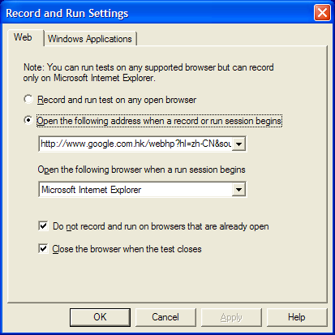
Recording and Run Setting

Slide 90
QTP Test Development Process
Prepare
Create
Enhance
Debug & Run
Prepare the automated test environment
Record user actions to generate a basic test
Enhance the automated test
Make test work well
Setup for test automation
Create a basic test
Enhance test
Debug and Run test
Document manual test steps
Check application environment stability
Check that data is valid
Record user actions
Confirm successful playback
Use Object Repository
Add synchronization
Insert checkpoints
Data drive the test
Debug
Run
Insert output
Add Steps
Add If Else statement
Add Loop statement

Slide 91
Useful Methods/Codes/Tool
Object.GetROProperty & Object.SetTOProperty
Reporter.ReportEvent
Change QTP Web Object to DOM Object

Slide 92
Report..
AssetCount = Browser("Browser").Page("WebPage").WebEdit("Asset Count").GetROProperty("Value")
If CStr(AssetCount) <> “1” Then
Reporter.ReportEvent micFail, "Asset Count", "the expected result was 1, but actual result is " & AssetCount
Else
Reporter.ReportEvent micPass, "Asset Count", "the expected result was 1, but actual result is " & AssetCount
End If

Slide 93
GetROProperty vs. SetTOProperty
ButtonName=Browser("QA Home Page").Page("QA Home Page").WebButton("Submit").GetTOProperty("Name")
Browser("Browser").Page("WebPage").WebEdit("Asset Count"). SetTOProperty "Value“, 1

Slide 94
Change QTP Web Object to DOM Object
Browser(“google”).Page(“google”).WebButton(“Q”).Object.Click
Browser(“google”).Page(“google”).WebButton(“Q”).Object.Name

Slide 95
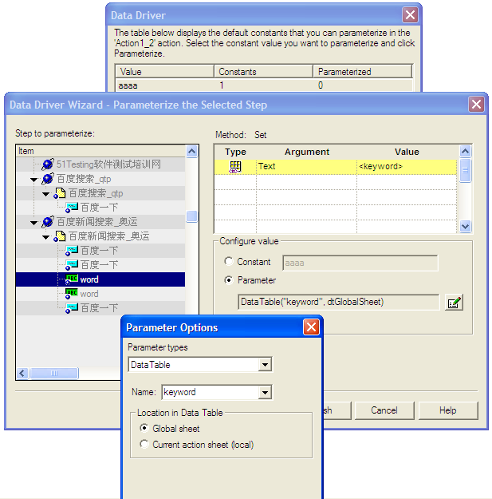
Cool Tool
Step Generator
Function Definition Generator
Data Driver (Parameterized)
Report
Synchronization Point

Slide 96
QTP Test Development Process
Prepare
Create
Enhance
Debug & Run
Prepare the automated test environment
Record user actions to generate a basic test
Enhance the automated test
Make test work well
Setup for test automation
Create a basic test
Enhance test
Debug and Run test
Document manual test steps
Check application environment stability
Check that data is valid
Record user actions
Confirm successful playback
Use Object Repository
Add synchronization
Insert checkpoints
Data drive the test
Debug
Run
Insert output
Add Steps
Add If Else statement
Add Loop statement

Slide 97
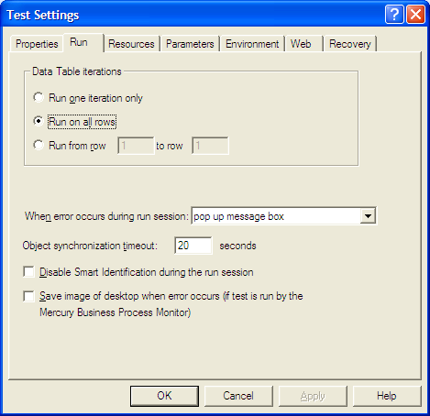
Test Setting

Slide 98
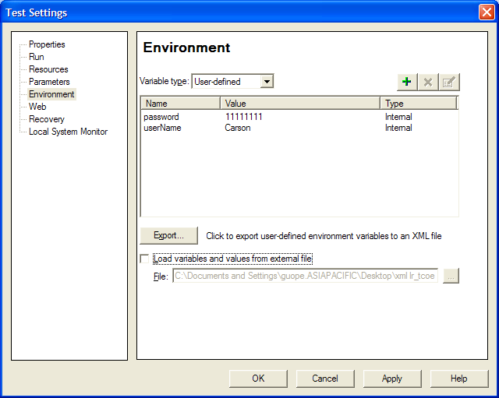
Environment

Slide 99
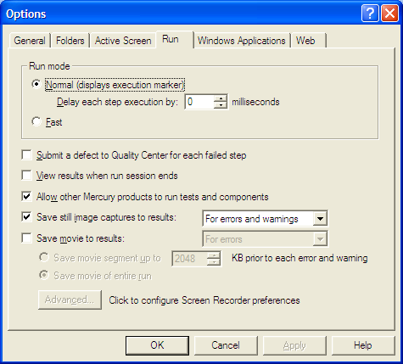
QTP Options

Slide 100
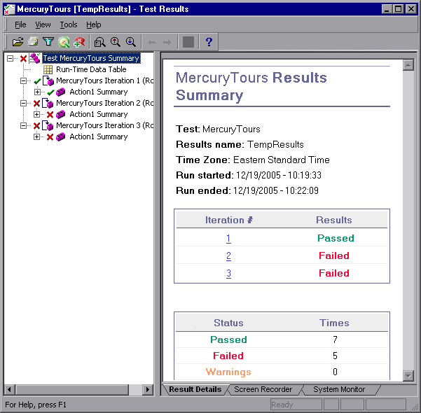
QTP Test Results

Slide 101
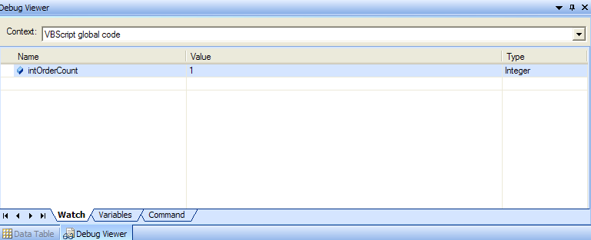
Debugging
Watch
Variables
Command
Syntax Check
Break point

Slide 102
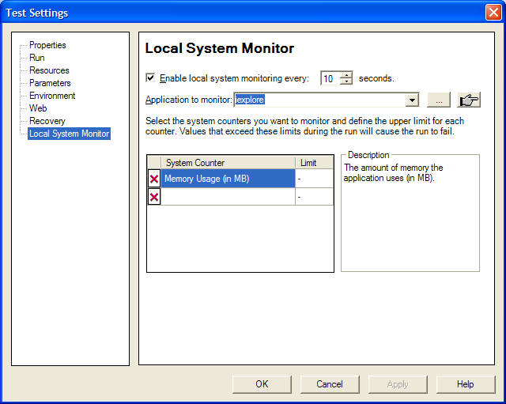
Local System Monitor

Slide 103
QTP Learning Guide
QTP Automation Engineer Basic Skills
QTP Documentations
Sample Applications

Slide 104
QTP Automation Engineer Basic Skills
VBScript
Using QTP well
Windows Application Technology
Web Technology (Html)

Slide 105
QTP Documentations
QTUsersGuide.pdf
QTTutorial.pdf
VBScript56.CHM
Web.chm
StdWin.chm
Utility.chm

Slide 106
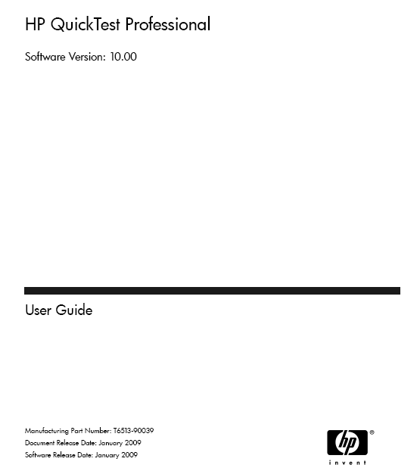
QTUsersGuide.pdf

Slide 107
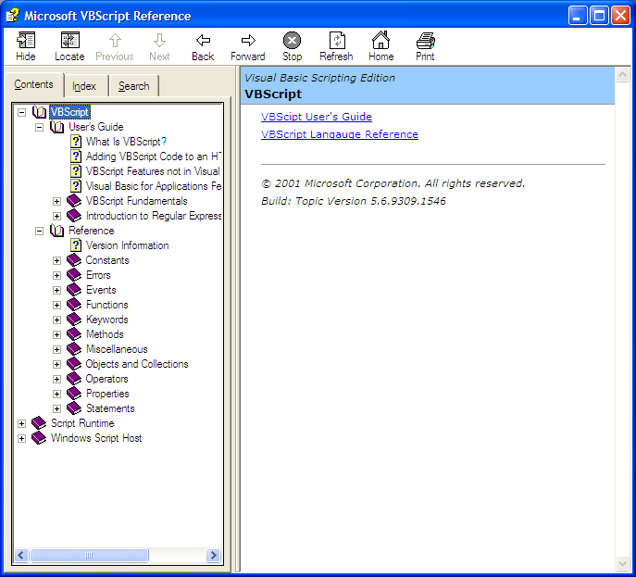
VBScript Reference

Slide 108
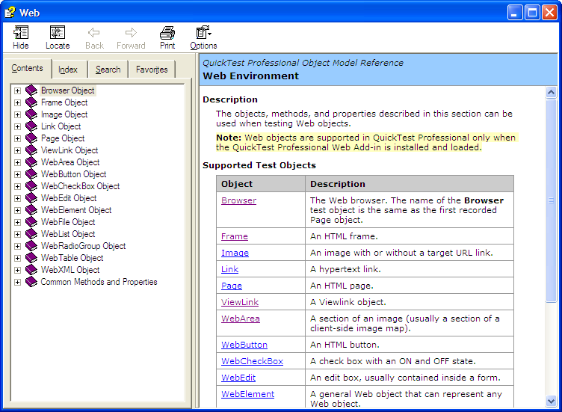
Web Objects
Objects
Method

Slide 109
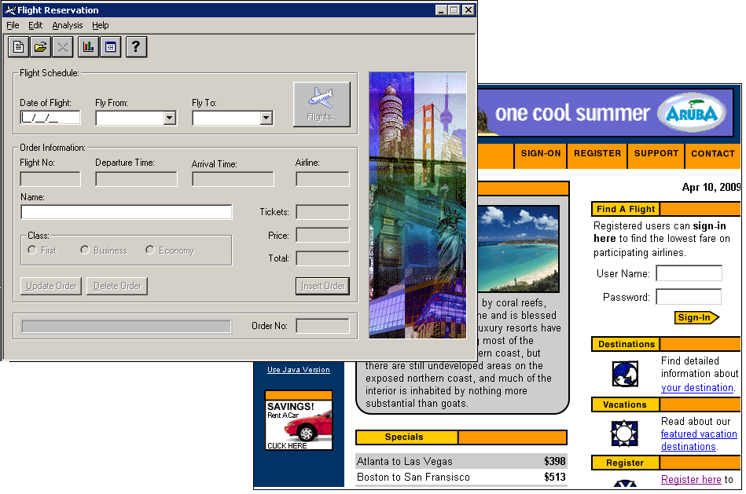
Sample Applications

Slide 110
Practice
Navigate to Mercury Tour Websites http://newtours.demoaut.com/index.php
Login to website, check logon successfully
Click Flights link, verify that you go to Flight screen
Enter city, data info and click continue button, verify that correct flight returned
Select flights you want, click continue button, verify that amount calculation correctly
Enter passengers info, credit info, and click Secure Purchase button, verify that a message displays ‘Your itinerary has been booked! ‘ , output itinerary info

Slide 111
Thank You!

